Slide 1
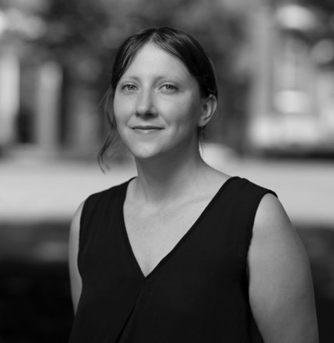
Kavli NDI Fellows
Chalk Talks
Wednesday, April 24th, 2024
12:00 p.m.
INVITED SPEAKER
Dr Jennifer Lawlor
PostDoctoral Scholar Kucchibotla Lab
LOCATION
Kavli North JHU Homewood Campus
Title:
Long-range circuits for learning of audiomotor tasks: investigating cholinergic control of sensorimotor acquisition

